Slide 1
Single Sign-On Authentication
Integration with Microsoft Active Directory

Slide 2
The traditional Approach
Current authorization: Integrator and iEnabler
A new approach
JSON Web Token
SSO with desktop clients
Web browsers and HTTP clients - SAML
Web browsers and HTTP clients – API
ITS Infinity

Slide 3
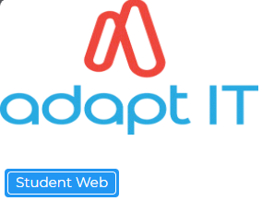
The Traditional ITS approach to managing access to:

Slide 4
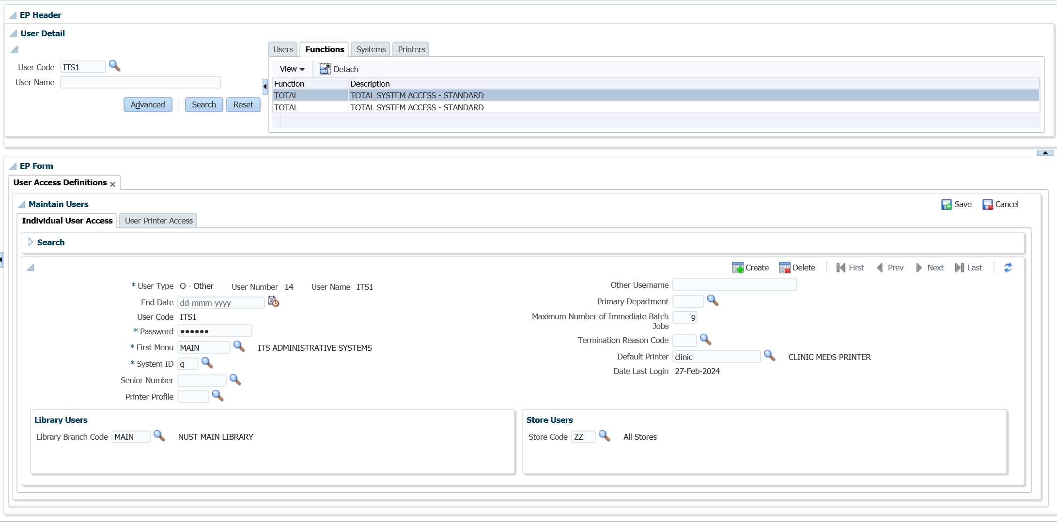
The Traditional Approach
Integrator: Username/Password Authentication
Notes:
Username/Password Authentication
Currently authentication is managed through OID (Oracle Internet Directory).
Integrator users are managed via the Integrator Application, which in turn maintains user details within OID.
In username/password authentication, a user ID and password are requested from the user and sent to WebLogic Server.
WebLogic Server checks the information and if it is trustworthy, grants access to the protected WebLogic resource.
Secure Sockets Layer (SSL), or Hyper-Text Transfer Protocol (HTTPS), can be used to provide an additional level of security to username/password authentication.
Because SSL encrypts the data transferred between the client and WebLogic Server, the user ID and password of the user do not flow in the clear.
WebLogic Server can authenticate the user without compromising the confidentiality of the user's ID and password.
Authorization
Authorisation is in turn maintained within the Integrator application using Functions linked to specific system options.

Slide 5
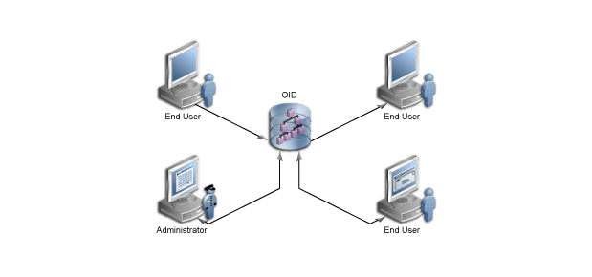
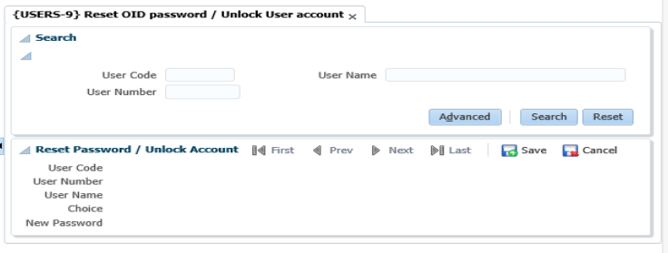
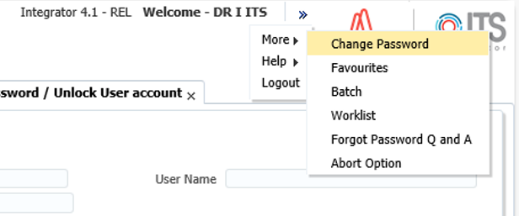
The Traditional Approach
Oracle Internet Directory
Notes:
What is Oracle Internet Directory?
An online directory is a specialized database that stores and retrieves collections of information about objects.
The information can represent any resources that require management, for example:
Employee names, titles, and security credentials
Information about partners
Information about shared resources such as conference rooms and printers.
The information in the directory is available to different clients, such as single sign-on solutions, email clients, and database applications.
Clients communicate with a directory server by means of the Lightweight Directory Access Protocol (LDAP).
Oracle Internet Directory is an LDAP directory that uses an Oracle Database for storage.

Slide 6
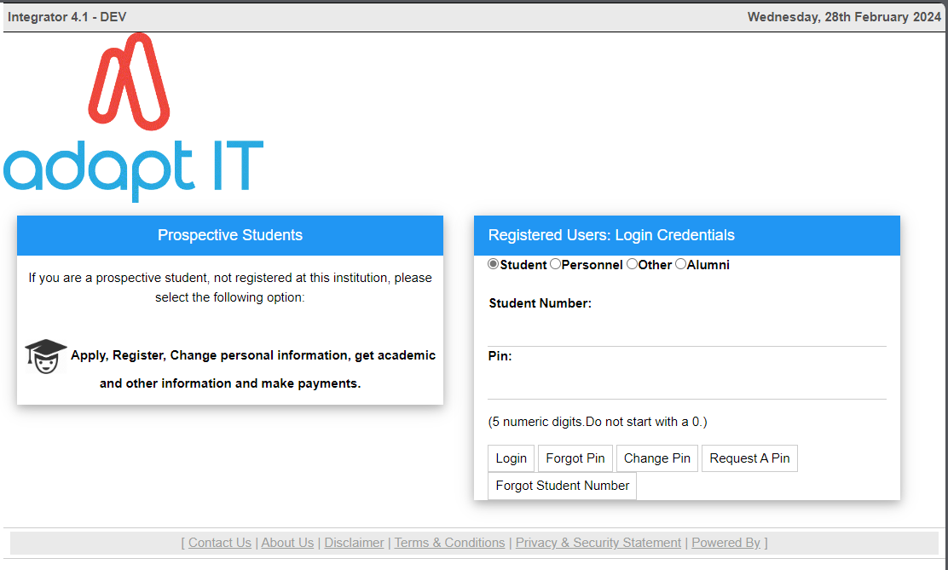
The Traditional Approach
iEnabler: Username/Pin Authentication
Notes:
Username/Password Authentication
iEnabler pins or pins and passwords are managed and obfuscated internally within Oracle making use of encryption for storage and retrieval.
HTTP traffic is controlled via the Weblogic server through a session cookie
Any session data is managed, encrypted and obfuscated within Oracle and linked to the WebLogic session, controlled by a configured timeout.

Slide 7
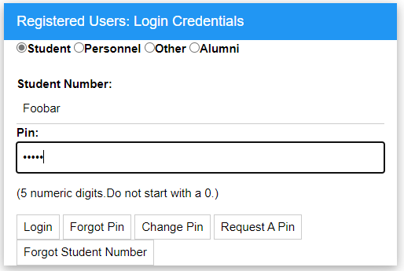
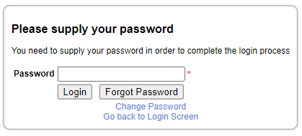
The Traditional Approach
iEnabler: Username/Pin and Additional Password Authentication
Notes:
Username/Pin/Password Authentication
Form of multi-factor authentication MFA
There is an SOD on {GCS2-11} called UP/GC, “Use Password Encryption on iEnabler”
The default value is “N”o. Alternatives is to use either ”Y”es in order to enforce the password for iEnabler login

Slide 8
The Traditional Approach
iEnabler: Username/Pin and Additional Password Authentication
Password management:
Change Password
If you have not yet been assigned a password or if you cannot remember your password use Forgot Password.
This will then email you a temporary password that you can use to reset your password.
The encryption level of this password by default is set to MD5 but can be changed to a higher value like SHA1, SHA256, SHA512.
The minimum password length defaults to 8 characters, but is system configured.
Locked Passwords (3 consecutive failures) will be unlocked after a system defined wait period.
Notes:
Username/Pin/Password Authentication
There is an SOD on {GCS2-11} called UP/GC, “Use Password Encryption on iEnabler”
The default value is “N”o. Alternatives is to use either ”Y”es in order to enforce the password for iEnabler login

Slide 9
The Traditional Approach
Secure Sockets Layer (SSL), or Hyper-Text Transfer Protocol
Notes:
Secure Sockets Layer (SSL), or Hyper-Text Transfer Protocol (HTTPS),
Provides an additional level of security to username/password authentication.
Because SSL encrypts the data transferred between the client and WebLogic Server, the user ID and password of the user do not flow in the clear.
WebLogic Server can authenticate the user without compromising the confidentiality of the user's ID and password.
Certificate Authentication
When an SSL or HTTPS client request is initiated, WebLogic Server responds by presenting its digital certificate to the client.
The client then verifies the digital certificate and an SSL connection is established.
The digital certificate is issued by an entity (a trusted certificate authority), which validates the identity of WebLogic Server.
You can also use two-way SSL authentication, a form of mutual authentication.
With two-way SSL authentication, both the client and server must present a certificate before the connection thread is enabled between the two. See One-way/Two-way SSL Authentication.
WebLogic Security Service Architecture (oracle.com)

Slide 10
The Traditional Approach
We are currently developing for Authentication
Notes:
Technically
When an HTTP server wishes to login a Microsoft client, it returns a 401 Unauthorized response to the HTTP request with the WWW-Authorization:Negotiate header.
The browser then contacts the Key Distribution Center (KDC)/Ticket Granting Service (TGS) to obtain a service ticket.
It chooses a special Service Principal Name for the ticket request. The returned ticket is then wrapped in a SPNEGO token which is encoded and sent back to the server using an HTTP request.
The token is unwrapped and the ticket is authenticated. Once authenticated, the page corresponding to the requested URL is returned.

Slide 11
Web Browsers and HTTP Clients – Seamless 3rd Party iEnabler Authentication
JSON Web Token
A JSON web token(JWT) is JSON Object which is used to securely transfer information over the web(between two parties). It can be used for an authentication system and can also be used for information exchange.
This function receives a JSON Web Token (JWT) containing the student’s student number and a timestamp
The private key for Signing and Verifying the JWT token is stored in Integrator {GCS2-11} for S4/GC.
Notes:
Technically
When an HTTP server wishes to login a Microsoft client, it returns a 401 Unauthorized response to the HTTP request with the WWW-Authorization:Negotiate header.
The browser then contacts the Key Distribution Center (KDC)/Ticket Granting Service (TGS) to obtain a service ticket.
It chooses a special Service Principal Name for the ticket request. The returned ticket is then wrapped in a SPNEGO token which is encoded and sent back to the server using an HTTP request.
The token is unwrapped and the ticket is authenticated. Once authenticated, the page corresponding to the requested URL is returned.

Slide 12
Web Browsers and HTTP Clients – Seamless 3rd Party iEnabler Authentication
Process:
Student/Staff login to customer portal and clicks a link to access Student/Staff iEnabler.
Portal then utilizes the student number, the current time and the secret key to create a JWT token.
The portal then uses this token to access the iEnabler for the relevant staff or student.
The system verifies the has been created by an approved 3rd party system.
The timestamp is checked to ensure that this request is not an old request.
At which time the student or Staff member identified inside the JWT is logged into the iEnabler.
https://jwt.io/ can be used to decode JWT tokens to view their attributes.
Notes:
Technically
When an HTTP server wishes to login a Microsoft client, it returns a 401 Unauthorized response to the HTTP request with the WWW-Authorization:Negotiate header.
The browser then contacts the Key Distribution Center (KDC)/Ticket Granting Service (TGS) to obtain a service ticket.
It chooses a special Service Principal Name for the ticket request. The returned ticket is then wrapped in a SPNEGO token which is encoded and sent back to the server using an HTTP request.
The token is unwrapped and the ticket is authenticated. Once authenticated, the page corresponding to the requested URL is returned.

Slide 13
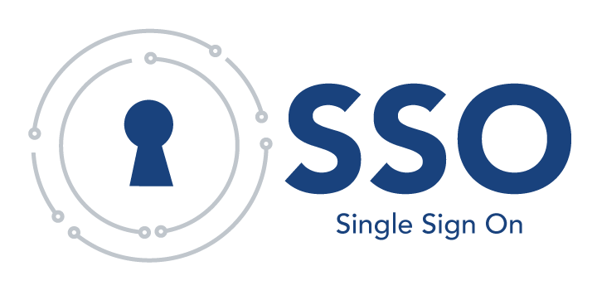
Single Sign-on (SSO) – A new approach
Single sign-on (SSO) enables users to log in securely to an application only once and gain access to many different application components, even if these components have their own authentication schemes.
Notes:
Technically
When an HTTP server wishes to login a Microsoft client, it returns a 401 Unauthorized response to the HTTP request with the WWW-Authorization:Negotiate header.
The browser then contacts the Key Distribution Center (KDC)/Ticket Granting Service (TGS) to obtain a service ticket.
It chooses a special Service Principal Name for the ticket request. The returned ticket is then wrapped in a SPNEGO token which is encoded and sent back to the server using an HTTP request.
The token is unwrapped and the ticket is authenticated. Once authenticated, the page corresponding to the requested URL is returned.

Slide 14
SSO with Desktop Clients – A new approach to Integrator Authentication
SSO with Desktop Clients uses HTTP-based authentication with Microsoft clients that have been authenticated in the Windows Active Directory (On-prem AD) environment.
The Windows Active Directory environment uses Kerberos as its security protocol.
Kerberos provides network authentication of heterogeneous realms.
This means a user logged into a Windows domain can access a Web application running on an application server and use their Windows Active Directory credentials to authenticate to the server.
The application server can run on any platform that supports Kerberos.
Notes:
Technically
When an HTTP server wishes to login a Microsoft client, it returns a 401 Unauthorized response to the HTTP request with the WWW-Authorization:Negotiate header.
The browser then contacts the Key Distribution Center (KDC)/Ticket Granting Service (TGS) to obtain a service ticket.
It chooses a special Service Principal Name for the ticket request. The returned ticket is then wrapped in a SPNEGO token which is encoded and sent back to the server using an HTTP request.
The token is unwrapped and the ticket is authenticated. Once authenticated, the page corresponding to the requested URL is returned.
Inhouse POC currently underway during this quarter.

Slide 15
Web Browsers and HTTP Clients via SAML – A new approach to iEnabler Authentication
The Security Assertion Markup Language (SAML) enables cross-platform authentication between Web applications or Web services running in a WebLogic Server domain and Web browsers or other HTTP clients.
WebLogic Server supports single sign-on (SSO) based on SAML.
When users are authenticated at one site that participates in a single sign-on (SSO) configuration, they are automatically authenticated at other sites in the SSO configuration and do not need to log in separately.
Notes:
Technically
When an HTTP server wishes to login a Microsoft client, it returns a 401 Unauthorized response to the HTTP request with the WWW-Authorization:Negotiate header.
The browser then contacts the Key Distribution Center (KDC)/Ticket Granting Service (TGS) to obtain a service ticket.
It chooses a special Service Principal Name for the ticket request. The returned ticket is then wrapped in a SPNEGO token which is encoded and sent back to the server using an HTTP request.
The token is unwrapped and the ticket is authenticated. Once authenticated, the page corresponding to the requested URL is returned.

Slide 16
Web Browsers and HTTP Clients via SAML – A new approach to iEnabler Authentication
SAML Identity provider (Like Microsoft AD) takes care of authentication management
User profiles
Password policies
MFA
Supports other federated services
ADFS
OneLogin
Azure AD
OKTA
Notes:
Technically
When an HTTP server wishes to login a Microsoft client, it returns a 401 Unauthorized response to the HTTP request with the WWW-Authorization:Negotiate header.
The browser then contacts the Key Distribution Center (KDC)/Ticket Granting Service (TGS) to obtain a service ticket.
It chooses a special Service Principal Name for the ticket request. The returned ticket is then wrapped in a SPNEGO token which is encoded and sent back to the server using an HTTP request.
The token is unwrapped and the ticket is authenticated. Once authenticated, the page corresponding to the requested URL is returned.

Slide 17
Web Browsers and HTTP Clients– A new approach to API Authentication
Our REST API Endpoints make use of the following concepts authorization
An authentication key is generated from:
Public key combinations.
Timestamp sensitive authentication keys.
API catalogue – families of common endpoints.
A passphrase is generated from:
The authentication key
Private key
Notes:
Technically

Slide 18
Infinity…
Currently Infinity authentication for applications is managed via
Google IDP – a valid email address
OTP verification of the address
For Admin authentication
Username and password
Verified against Back-end (Integrator)
For selections
Username and password (Admin)
Authorization defined in Admin roles and permissions module
Notes:
Technically

Slide 19
… and beyond
Open-Source Identity and Access Management
Add authentication to applications and secure services with minimum effort.
No need to deal with storing users or authenticating users.
Keycloak provides user federation, strong authentication, user management, fine-grained authorization, and more.
Users authenticate with Keycloak rather than individual applications. This means that your applications don't have to deal with login forms, authenticating users, and storing users
Enabling login with social networks
Authenticate users with existing OpenID Connect or SAML 2.0 Identity Providers
Built-in support to connect to existing LDAP or Active Directory servers
Notes:
Technically

Slide 20
… and beyond
WSO2 Identity Server is an API-driven open source identity and access management (IAM) product designed to help you build effective customer IAM (CIAM) solutions.
It is based on open standards such as SAML, OAuth, and OIDC with on-premise, cloud, and hybrid deployment options.
The key features of WSO2 Identity Server include:
Authentication: Try out login with SSO, MFA, identity federation, and self sign-up.
Identity Federation: Enable login using federated identity providers.
Access Delegation: Enable secure access delegation to third-party clients using OAuth.
Consent Management: Manage user consent when accessing a user’s resources.
User Management: Manage users and groups in your tenant organization.
Notes:
Technically
Images courtesy of
Blogspot.com
Oracle.com
AdaptIT.com
https://i.pinimg.com/
All-free-download.com

Slide 21
… and beyond
The key features of WSO2 Identity Server also include:
User Self-Service: Allow users to manage their own user profiles and accounts.
Tenant Management: Configure multi-tenancy to optimize resource sharing among users.
Claim Management: Manage claims and map them to user attributes.
Access Control: Use fine-grained access control when an app accesses user resources.
Notes:
Technically

Slide 22
… and beyond
in the cloud
AWS Identity and Access Management (IAM) Resources
How does IAM work and what can I do with it?
With IAM, you specify who or what can access services and resources in AWS, centrally manage fine-grained permissions, and analyze access to refine permissions across AWS.
IAM provides authentication and authorization for AWS services. A service evaluates if an AWS request is allowed or denied. Access is denied by default and is allowed only when a policy explicitly grants access. You can attach policies to roles and resources to control access across AWS.
AWS recommends using an identity provider and federating into AWS by assuming roles
Notes:
Technically
What are IAM roles and how do they work?
AWS Identity and Access Management (IAM) roles provide a way to access AWS by relying on temporary security credentials.
Each role has a set of permissions for making AWS service requests, and a role is not associated with a specific user or group.
Instead, trusted entities such as identity providers or AWS services assume roles.
What are IAM users and should I still be using them?
IAM users are identities with long-term credentials.
You might be using IAM users for workforce users.
In this case, AWS recommends using an identity provider and federating into AWS by assuming roles.
You also can use roles to grant cross-account access to services and features such as AWS Lambda functions. In some scenarios, you might require IAM users with access keys that have long-term credentials with access to your AWS account.
What are IAM policies?
IAM policies define permissions for the entities you attach them to. For example, to grant access to an IAM role, attach a policy to the role. The permissions defined in the policy determine whether reque
sts are allowed or denied. You also can attach policies to some resources, such as Amazon S3 buckets, to grant direct, cross-account access.

Slide 23
Notes:
Images courtesy of
Blogspot.com
Oracle.com
AdaptIT.com
https://i.pinimg.com/
All-free-download.com
Iconfinder.com
aws.amazon.com

